Slide 1
CS60055: Ubiquitous Computing
Location, Gesture and Activity Sensing
Part I: The Fundamentals of Motion Tracking

Slide 2
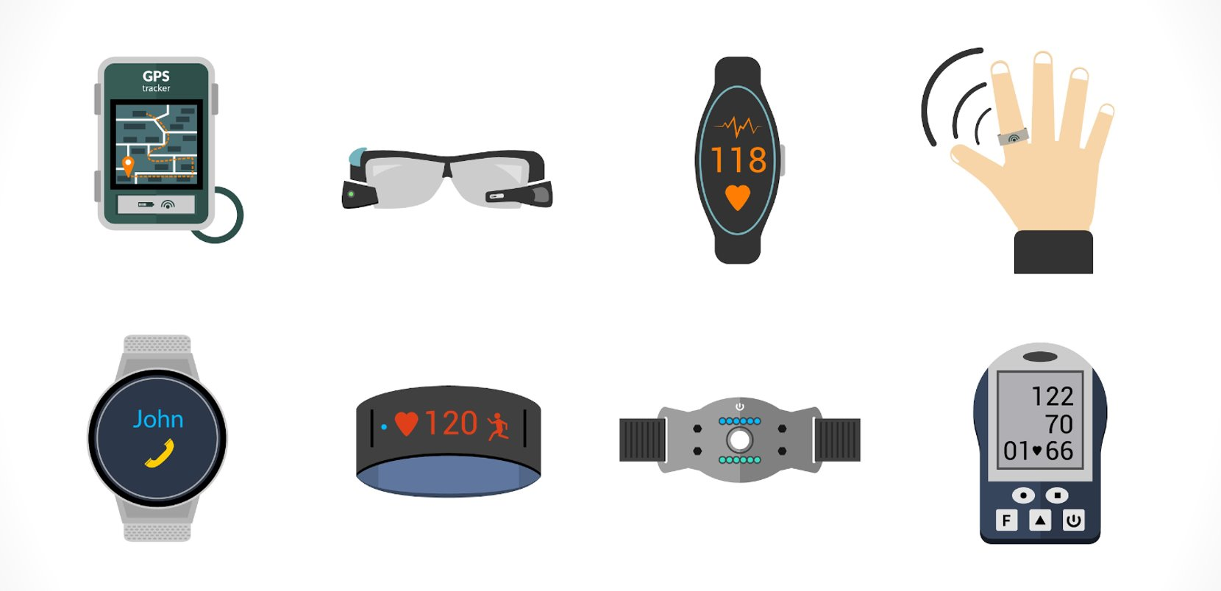
We are living in the edge of wearables ...

Slide 3
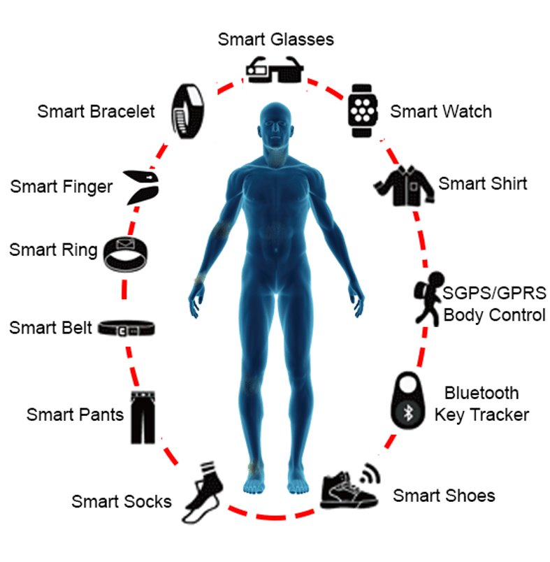
Wearables -- Head to Toe
Image source: https://doi.org/10.1109/ACCESS.2017.2789329

Slide 4

Range of Devices
Image source: https://doi.org/10.1249/jsr.0000000000000680

Slide 5
Sensors on Wearables
IMU
Altimeter
Bio-acoustic
Blood Pressure
Brightness
Camera
ECG
EDA
EMG
Fiber Optic Sensors
Compass
GPS
GSR
Humidity
Magnetometer
IR Proximity
IR Temperature
LED
Glucometer
Pressure
Microphone
Piezoelectric
RFID
Spectrometer
Thermometer
Textile sensors
Ultrasound
Weight
Optical sensor
mmWave sensor
Electrodes
Inductive wire
IR Photo Reflective

Slide 6

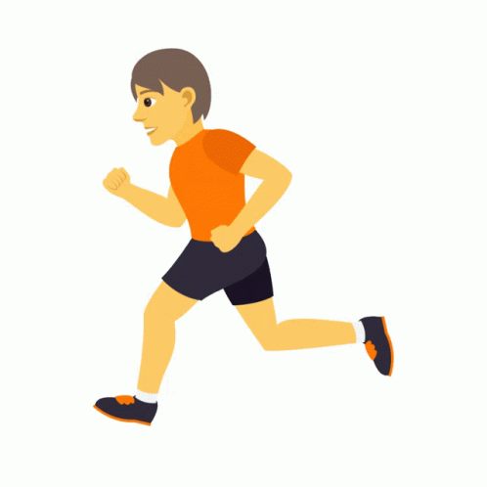
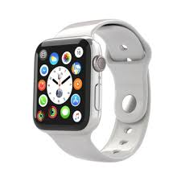
Our First Problem ...
vs
with a

Slide 7
IMU / Inertial Sensors
Accelerometer, Gyroscope, and sometime Magnetometer
Measures
  Specific force of a body
  Angular Rate
  Orientation
Detects the linear acceleration and the rotation rate (angular rate)
Also used for measuring the orientation of a device (one of the primary use-cases for wearables)
Largely used for maneuver in a 3D space and navigation purpose

Slide 8
Motion and the Frame of Reference
Rest Frame: The coordinate system in which the particle is at rest
Proper acceleration: Rate of change of velocity of a body in its instantaneous rest frame
  Acceleration relative to an observer who is in free fall (relative to an inertial frame of reference)
  Different from coordinate acceleration
  Accelerometer measures the proper acceleration

Slide 9
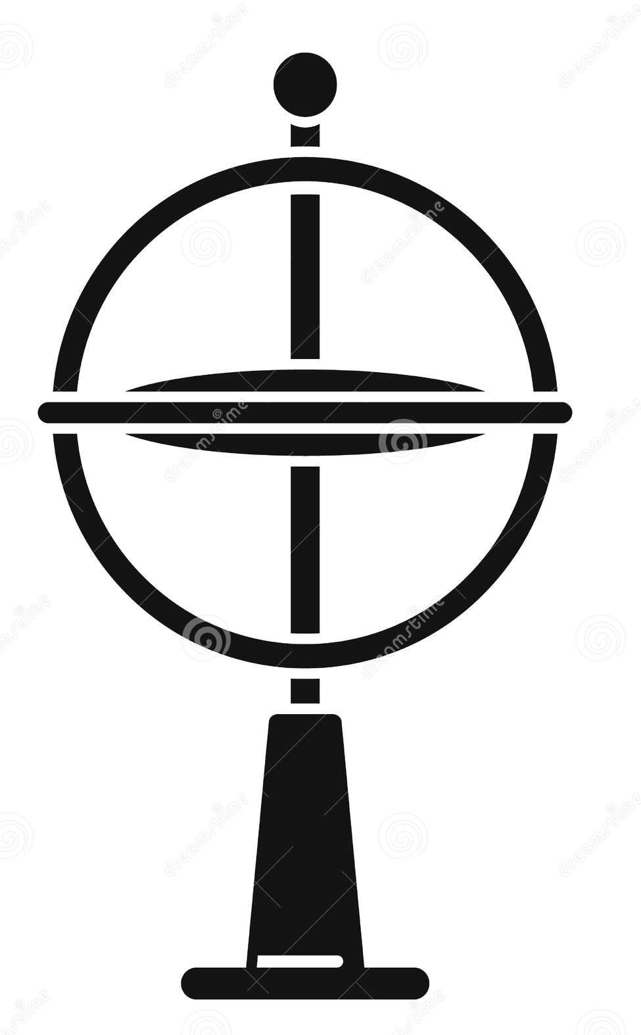

Motion and the Frame of Reference
Rest Frame: The coordinate system in which the particle is at rest
Proper acceleration: Rate of change of velocity of a body in its instantaneous rest frame
  Acceleration relative to an observer who is in free fall (relative to an inertial frame of reference)
  Different from coordinate acceleration
  Accelerometer measures the proper acceleration
What acceleration value would be reported by an
accelerometer placed on a table at our classroom?

Slide 10
Motion and the Frame of Reference
Rest Frame: The coordinate system in which the particle is at rest
Proper acceleration: Rate of change of velocity of a body in its instantaneous rest frame
  Acceleration relative to an observer who is in free fall (relative to an inertial frame of reference)
  Different from coordinate acceleration
  Accelerometer measures the proper acceleration
What acceleration value would be reported by an
accelerometer placed on a table at our classroom?
9.8 m/s²
0 m/s²
0 m/s²

Slide 11
Motion and the Frame of Reference
Rest Frame: The coordinate system in which the particle is at rest
Proper acceleration: Rate of change of velocity of a body in its instantaneous rest frame
  Acceleration relative to an observer who is in free fall (relative to an inertial frame of reference)
  Different from coordinate acceleration
  Accelerometer measures the proper acceleration
What acceleration value would be reported by an
accelerometer placed on a table at our classroom?
A free-fall accelerometer will read zero acceleration!
9.8 m/s²
0 m/s²
0 m/s²

Slide 12
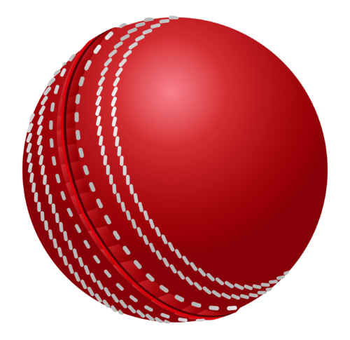
Motion and the Frame of Reference
Rest Frame: The coordinate system in which the particle is at rest
Proper acceleration: Rate of change of velocity of a body in its instantaneous rest frame
  Acceleration relative to an observer who is in free fall (relative to an inertial frame of reference)
  Different from coordinate acceleration
  Accelerometer measures the proper acceleration
Assume that the ball is in rest

Slide 13
Motion and the Frame of Reference
Rest Frame: The coordinate system in which the particle is at rest
Proper acceleration: Rate of change of velocity of a body in its instantaneous rest frame
  Accelerometer measures the proper acceleration
Can we represent the motion of every object with this principle?

Slide 14

Consider the following scenario ...
With an accelerometer mounted on Mr. Bean's headphone, can you detect that he is enjoying the music?

Slide 15
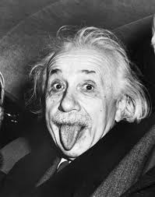
Equivalence Principle and Its Impact
“A little reflection will show that the law of the equality of the inertial and the gravitational mass is equivalent to the assertion that the acceleration imparted to a body by a gravitational field is independent of the nature of the body. For Newton’s equation in motion in a gravitational field, written out in full, it is:
(inertial mass).(acceleration) = (intensity of the gravitational field).(Gravitational mass)
It is only when there is numerical equality between the inertial and gravitational mass that the acceleration is independent of the
nature of the body.”

Slide 16
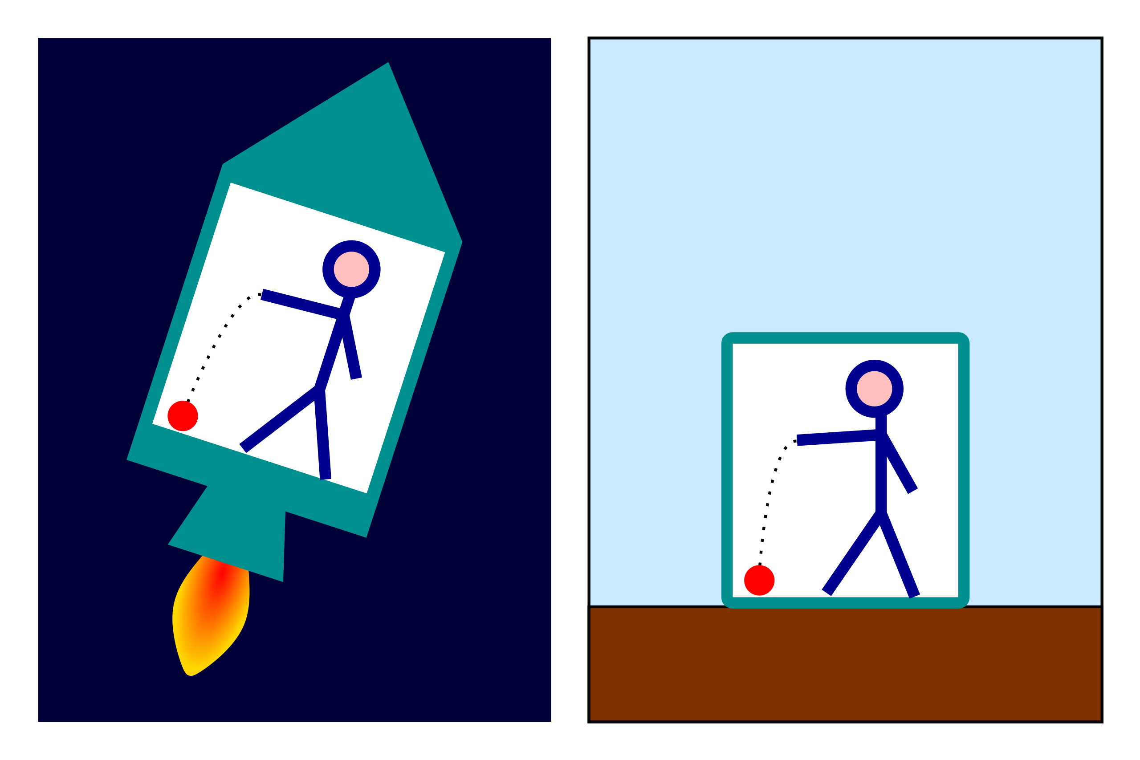
Equivalence Principle and Its Impact
A falling object behaves exactly the same on a planet or in an equivalent accelerating frame of reference.
Image Source: Wikipedia

Slide 17
Equivalence Principle and Its Impact
In its simplified form: The effects of gravity on an object are indistinguishable from its acceleration
Z
Y
X

Slide 18
Equivalence Principle and Its Impact
In its simplified form: The effects of gravity on an object are indistinguishable from its acceleration
Z
Y
X
g

Slide 19
Equivalence Principle and Its Impact
In its simplified form: The effects of gravity on an object are indistinguishable from its acceleration
Z
We call this reference frame as the local inertial frame of the object
Y
X
g

Slide 20
Equivalence Principle and Its Impact
In its simplified form: The effects of gravity on an object are indistinguishable from its acceleration
Accelerometer measures the acceleration with respect to this local inertial frame
Z
We call this reference frame as the local inertial frame of the object
Y
X
g

Slide 21
Equivalence Principle and Its Impact
In its simplified form: The effects of gravity on an object are indistinguishable from its acceleration
Accelerometer measures the acceleration with respect to this local inertial frame
Z
We call this reference frame as the local inertial frame of the object
Y
The "gravity offset" must be subtracted to obtain the actual acceleration, when the object moves on the earth's surface
X
g

Slide 22
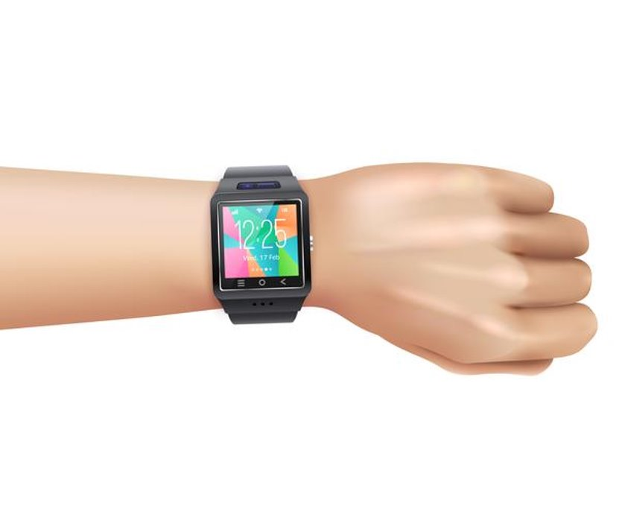
Impact of Rotation

Slide 23

Impact of Rotation
Z
X
Y
The gravity offset is towards the y-axis

Slide 24
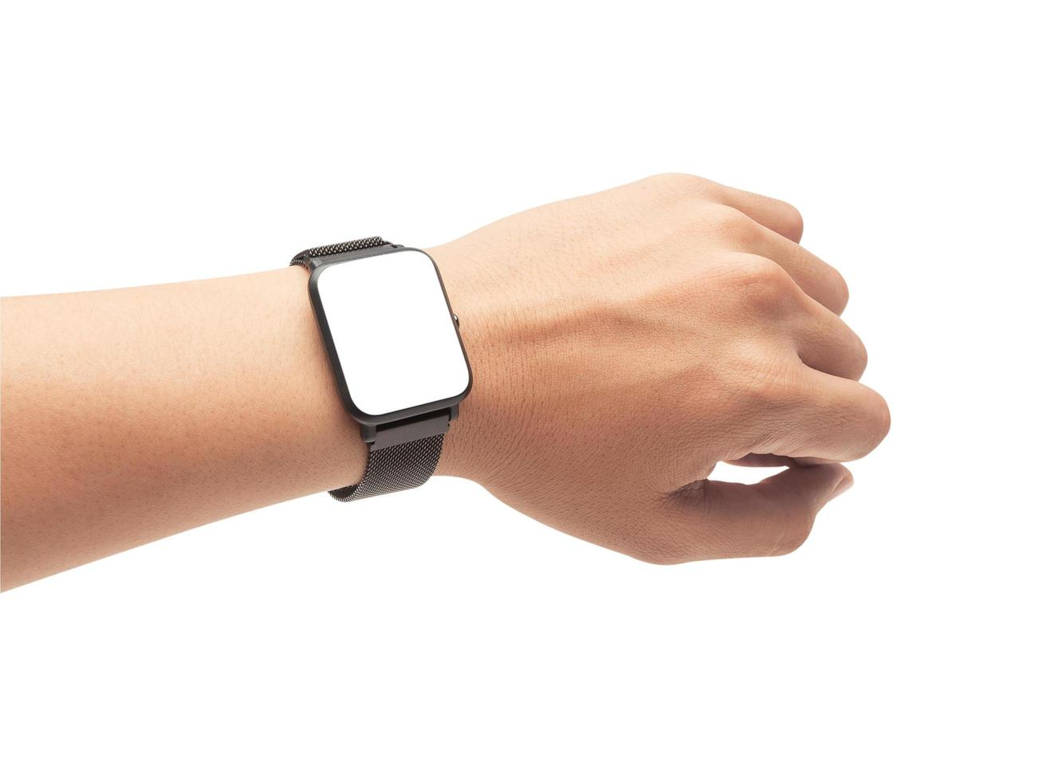
Impact of Rotation
The local inertial frame changes due to the rotation
Z
Z
X
X
Y
Y
The gravity offset gets different impact on different axes -- how to subtract the gravity offset?

Slide 25
Impact of Rotation
Z
Z
X
X
Y = g
Y
Y ≠ g
Y

Slide 26
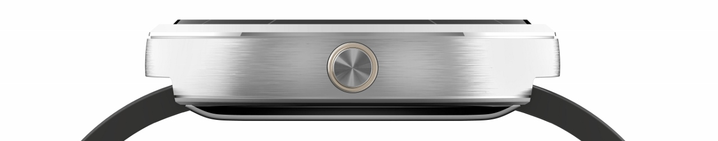
Angle Transformation
Z
Y
X

Slide 27
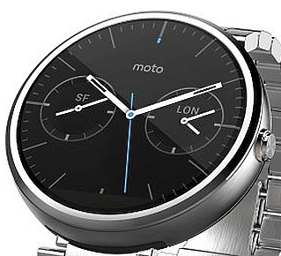
Angle Transformation
Z
z
y
We need to figure out the components of the gravity offset on each of the components of the local inertial frame
Y
x
X

Slide 28
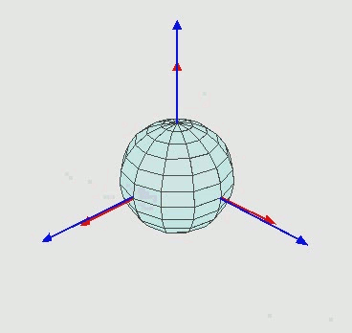
Orientation Update
Image source: Wikipedia

Slide 29
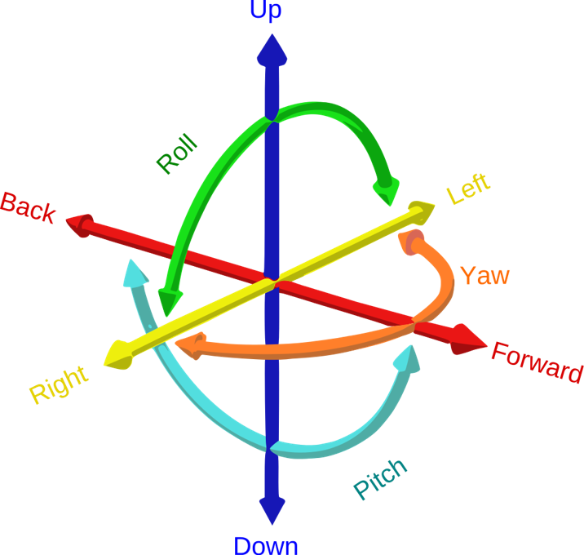
Six Degrees of Freedom
The three angles, roll, pitch and yaw are called the Euler angles to denote the orientation of an object, with respect to a frame of reference
Image Source: Wikipedia

Slide 30
Euler Angle and Angle Transformation
Z
Φ = Roll
Θ = Pitch
Ψ = Yaw
z
y
Φ
Y
x
X
Step 1: Rotate the Z-Y plane on the roll angle to adjust the Z axis (rotation across X-axis)

Slide 31
Euler Angle and Angle Transformation
z'
Z
Φ = Roll
Θ = Pitch
Ψ = Yaw
z
y
Φ
y'
Φ
Y
x
X
When you try to adjust the Z-axis, the Y-axis also observes an additional rotation on the roll angle

Slide 32
Euler Angle and Angle Transformation
z'
Z
Φ = Roll
Θ = Pitch
Ψ = Yaw
z
y
Φ
y'
Y
x
Θ
X
Step 2: Rotate the X-Z plane on the pitch angle to adjust the X-axis (Rotation across Y-axis)

Slide 33
Euler Angle and Angle Transformation
z'
Z
Φ = Roll
Θ = Pitch
Ψ = Yaw
z
y
Φ
y'
Y
x
Θ
X
The Y-axis needs to be adjusted now!

Slide 34
Euler Angle and Angle Transformation
z'
Z
Φ = Roll
Θ = Pitch
Ψ = Yaw
z
y
Φ
y'
Ψ
Y
x
Θ
X
Step 3: Rotate the Y-X plane for the yaw angle with respect to the Z-axis

Slide 35
Computing the Euler Angles
Consider two reference frames R₁ and R₂. Let R₁ be the fixed reference frame of the observer and R₂ be the local reference frame of the object. To figure out the orientation of the object, we need to rotate the object to transform R₂ to R₁
  The rotations follow right hand thumb rules, and always in the right (clockwise) direction
  The first rotation with respect to any one of the three axes x, y or z
  The second rotation along with a different axis
  The third rotation either w.r.t. the first axis or the leftover axis
  We have 12 possible combinations in this way: 1-2-1, 1-3-1, 2-1-2, 2-3-2, 3-1-3, 3-2-3, 1-2-3, 1-3-2, 2-3-1, 2-1-3, 3-1-2, 3-2-1
  The 3-2-1 (yaw, pitch, roll) is one of the most popular ones, and used widely in aircraft navigation

Slide 36
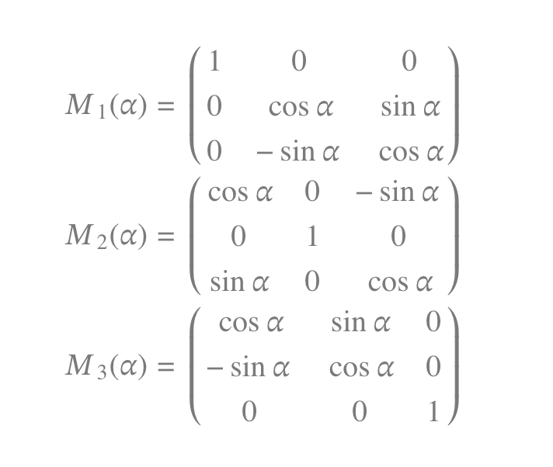
Computing the Euler Angles
The rotational matrices across the three axes (corresponds to the three rotations is given by):
We can replace α with the corresponding roll, pitch or the yaw angles depending on the rotations. For example, for 3-2-1 rotations, the angles corresponding to M1, M2, and M3 would be the roll, the pitch, and the yaw angles

Slide 37
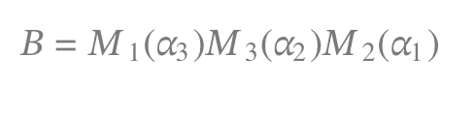
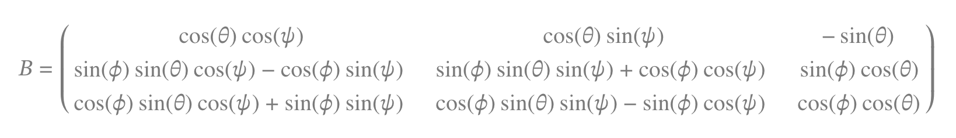
Computing the Euler Angles
Subsequently, the Direction Cosine Matrix (DCM) is computed as the multiplication of the three rotational matrices across the three axes reading from right two left.
Ex: The DCM for the 2-3-1 Euler angles will be evaluated as follows:
Similarly, the DCM for a 3-2-1 Euler angle will look as follows.

Slide 38
Computing the Euler Angles
X'
Let [a_{x}, a_{y}, a_{z}] be the acceleration reading on the tilted frame T(X'Y'Z')
Acceleration on the level frame L(XYZ) is [0 0 g]
We consider 3-2-1 Euler angle (Yaw Pitch Roll)
Can we observe gravity's impact on the three axes of the accelerometer, and based on the acceleration values, measure the Euler angles?
+pitch Θ
X
Y
Z'
+roll Φ
Y'
Z
g = 9.81 m/s²

Slide 39
Computing the Euler Angles
X'
Let [a_{x}, a_{y}, a_{z}] be the acceleration reading on the tilted frame T(X'Y'Z')
Acceleration on the level frame L(XYZ) is [0 0 g]
We consider 3-2-1 Euler angle (Yaw Pitch Roll)
Can we observe gravity's impact on the three axes of the accelerometer, and based on the acceleration values, measure the Euler angles?
  This will help us to compute the orientation of the object when in static
+pitch Θ
X
Y
Z'
+roll Φ
Y'
Z
g = 9.81 m/s²

Slide 40
Computing the Euler Angles
X'
However, using acceleration, we can only compute the roll and the pitch angles, but now the yaw angle
  As gravity is always downwards (z-axis), a rotation across the z-axis will not have any impact on the accelerometer readings
+pitch Θ
X
Y
Z'
+roll Φ
Y'
Z
g = 9.81 m/s²

Slide 41
Computing the Euler Angles
X'
However, using acceleration, we can only compute the roll and the pitch angles, but now the yaw angle
  As gravity is always downwards (z-axis), a rotation across the z-axis will not have any impact on the accelerometer readings
  So, we ignore the yaw angle
+pitch Θ
X
Y
Z'
+roll Φ
Y'
Z
g = 9.81 m/s²

Slide 42
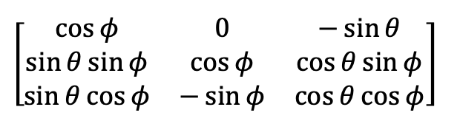
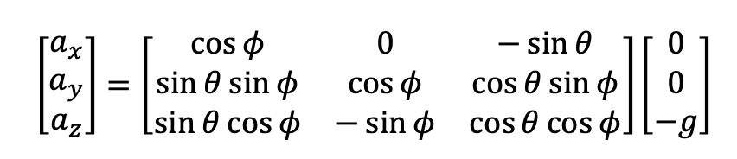
Computing the Euler Angles
X'
Let us assume the yaw angle to be zero
We obtain the following DCM:
Now, we can have the kinematic equations as follows:
+pitch Θ
X
Y
Z'
+roll Φ
Y'
Z
g = 9.81 m/s²

Slide 43
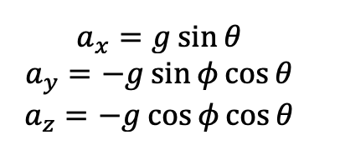
Computing the Euler Angles
X'
We obtain the following equations by multiplying the matrices:
+pitch Θ
X
Y
Z'
+roll Φ
Y'
Z
g = 9.81 m/s²

Slide 44
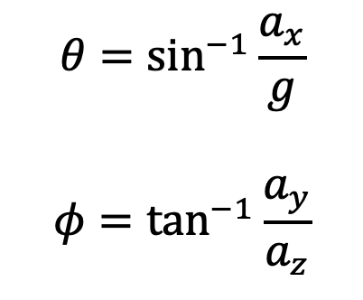
Computing the Euler Angles
X'
We obtain the following equations by multiplying the matrices:
Finally, we obtain the roll and the pitch angles as follows:
+pitch Θ
X
Y
Z'
+roll Φ
Y'
Z
g = 9.81 m/s²

Slide 45
Computing the Euler Angles
But how do we compute the yaw angle?

Slide 46
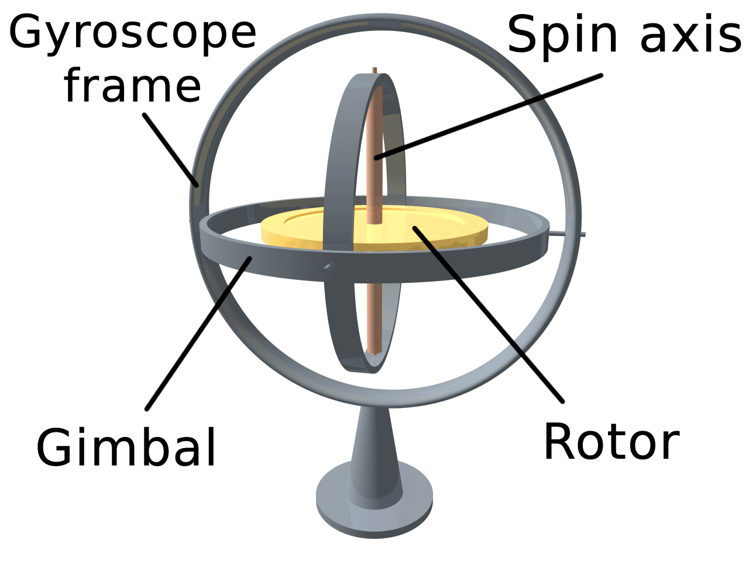
Computing the Euler Angles
But how do we compute the yaw angle?
We need a second modality: Gyroscope

Slide 47
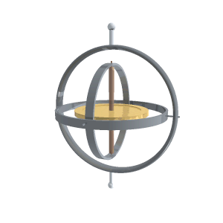
Gyroscopes
Measures the angular velocity and the orientation of the object
  Angular velocity is measured based on the rotation rate with respect to an inertial frame
  We already know the roll and the pitch angle from the
  accelerometer
  The measured angular velocities across the three axes
  are then used to compute the orientation
  (the yaw angle)
Image Source: Wikipedia

Slide 48
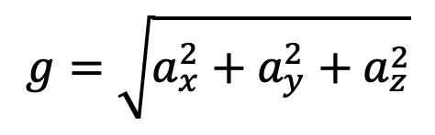
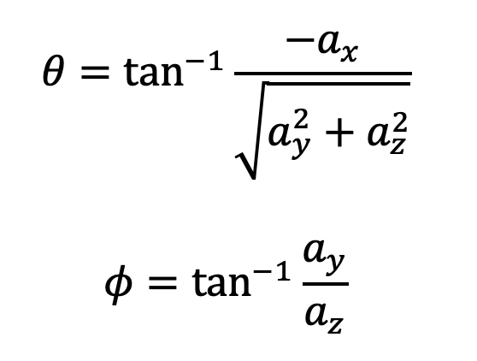
Putting them all together ...
We know,
Accordingly, we can compute the roll and the pitch angles as;

Slide 49
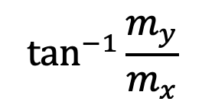
Putting them all together ...
Gyroscope measures the angular velocity [ω_{x}, ω_{y}, ω_{z}]
  Multiplying these values with the time (δ_{t}) will give the angular movement within these time unit, which is indeed the three angles -- roll, pitch and yaw
However, the orientation angles calculated with this method return noisy values (due to minute calculation of the time)
  So, IMU (Inertial Measurement Units – combine acclerometer, gyroscope, and magnetometer) uses a Kalman Filter or Complimentary filter based approach to reduce the measured noises with the help of roll and pitch values computed from the accelerometer
    Indeed, it also takes help of the yaw computed from magnetometer as

Slide 50
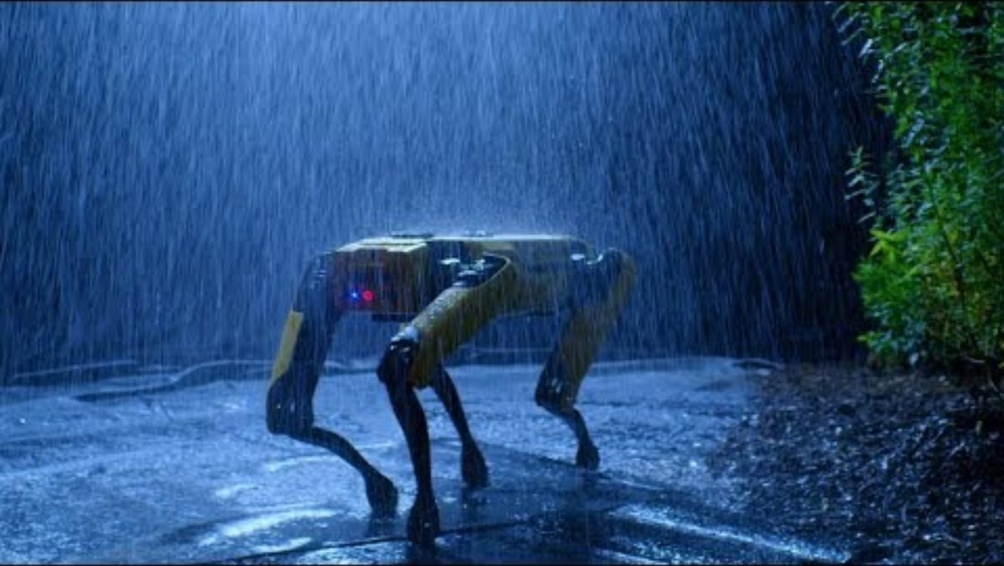
An Interesting Use-case of Gyroscope

Slide 51

How Can We Use Gyroscope for Self-Balancing?

Slide 52

From Motion to Gesture
Can you think of a method to generate a digital representation of the boardwork from the IMU sensor readings obtained from the smartwatch?
Image generated by ChatGPT 4o

Slide 53





Happy Learning!
Some resources related to this topic

